Slide 1

3-umpire mechanics

Slide 2
The objectives of
3-umpire mechanics
Try to keep one umpire AHEAD of the lead runner
If possible, “box” the runner between the three umpires
Notes:
Objectives
Keep one umpire ahead of the lead runner
Ideally
“Box” the runner between the three umpires
One behind him
One with him
One ahead of him

Slide 3
Field Umpire
Positions
C
B
A
D
C
A
D
Notes:
DEEP A
No runner on first or second
SHALLOW A
With a runner on first
Need to see the pitcher, runner, and base
You are there for the pickoff play or throwback by the catcher
SHALLOW B
Not generally used
DEEP B
Position for U1 with a Runner on 2nd, but not on 1st
SHALLOW C
Used by U3 with a runner on 1st and 2nd
DEEP C
Used by U3 with runners on 1st, 1st and 3rd, or bases loaded
DEEP D
Used by U3 when there are no runners or a runner on 2nd base only
SHALLOW D
Used by U3 when there is a runner on third, but not 1st
Need to see the pitcher, runner, and base
You are there for the pickoff or throwback by the catcher

Slide 4



Umpire Positions
NO Runners
Notes:
U1 in DEEP A
U3 in DEEP D

Slide 5

Umpire Positions
Runner on 1st
U3 can be in
Deep B or Deep C
Notes:
U1 in SHALLOW A
Best positioning for the pickoff or throwback by the catcher
U3 in DEEP C
Best positioning for the steal of second

Slide 6
Umpire Positions
Runner on
1st & 2nd
Notes:
U1 in SHALLOW A
U3 in SHALLOW C
Best position for the steal of third

Slide 7

Umpire Positions
Runner on
1st & 3rd
Notes:
U1 ins SHALLOW A
U3 in DEEP C
Best position for the steal of second, pickoff at third, or throwback to third by the catcher

Slide 8
Umpire Positions
Runner on
1st, 2nd & 3rd
Notes:
U1 in SHALLOW A
U3 in DEEP C

Slide 9
Anytime there is a
RUNNER on 1st
U3 will be in “B or C”
Notes:
Do you see a pattern here?
Anytime there is a runner on 1st, U3 is in “C”

Slide 10
Umpire Positions
Runner on
2nd
Notes:
U1 in DEEP B
Best position for the pickoff at 2nd
U3 in DEEP C

Slide 11
Umpire Positions
Runner on
2nd & 3rd
Notes:
U2 in DEEP B
U3 in SHALLOW D

Slide 12
With LESS than 2 Outs
Anytime there is a
RUNNER on 2nd, but
NO RUNNER on 1st
U1 will be in “B”
Notes:
Here’s another “pattern”
Anytime there is a runner on 2nd, but NOT on 1st, U2 will be in “B”

Slide 13
Umpire Positions
Runners on 2nd
WITH 2 Outs
(OPTIONAL)

Slide 14
Umpire Positions
Runners on
2nd & 3rd
WITH 2 Outs
(Optional)

Slide 15
WITH 2 Outs
As a CREW OPTION
RUNNER on 2nd or RUNNERS on 2nd & 3rd, but NO RUNNER on 1st
U1 will be in “A”

Slide 16
Umpire Positions
Runner on
3rd
Notes:
U1 in DEEP A
U3 in SHALLOW D

Slide 17
Quick Guide for knowing when to be
“inside” versus “outside”
Anytime there is a
RUNNER on 2nd, but
NO RUNNER on 1st
U1 will be in “B”
(except for Crew Option
with 2 out and runner(s)
on 2nd or 2nd and 3rd)
OTHERWISE
U1 will always be in “A”
Anytime there is a
RUNNER on 1st
U3 will be in “B” or “C”
OTHERWISE
U3 will always be in “D”
(except for Crew Option
with 2 outs and runner(s)
on 2nd or 2nd and 3rd)
Notes:
This is an easy way to remember where you should be in 3-umpire mechanics.
Forget everything else (trying to remember all of the different runner configurations).
It all boils down to this

Slide 18
Positioning for Plays at 3rd
With U3 “Outside”
Optional
(U3 ONLY)
Preferred

Slide 19
Positioning for Plays at 3rd
With U3 “Inside”

Slide 20
CHECK SWINGS
Go to the “Open” umpire
  U1 for RIGHT handed batters
  U3 for LEFT handed batters
Notes:
Check swings
PL will go the “open” umpire
U1 at 1st or in “B” for RIGHT handed batters
U3 at 3rd or in “C” for LEFT handed batters

Slide 21
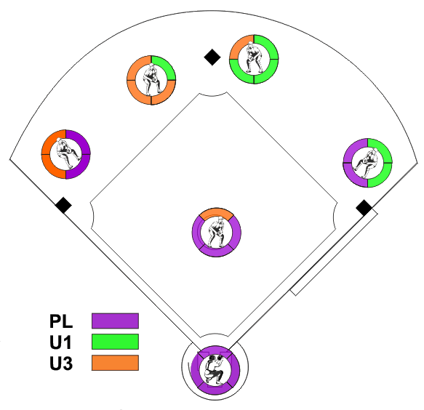
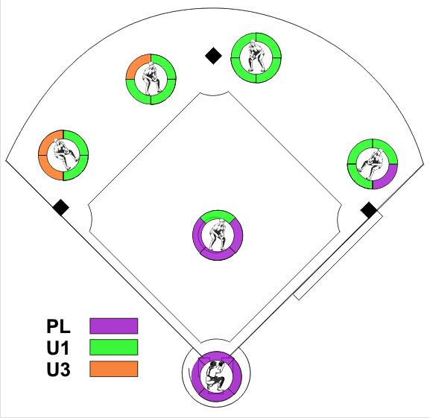
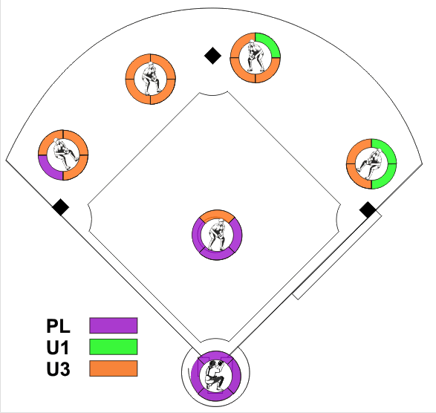
INFIELD
Catch / No Catch
Responsibilities
U1 & U3 on the corners
U1 Inside
U3 Inside

Slide 22
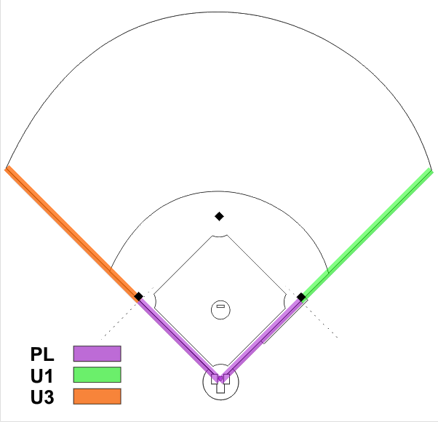
Fair / Foul
U1 & U3
On the corners
Notes:
With U1 and U3 “on the wings”
PL has responsibility up to the front edge of first or third base
U1 has from the front edge of first base to the fence
U3 has from the front edge of third base to the fence

Slide 23
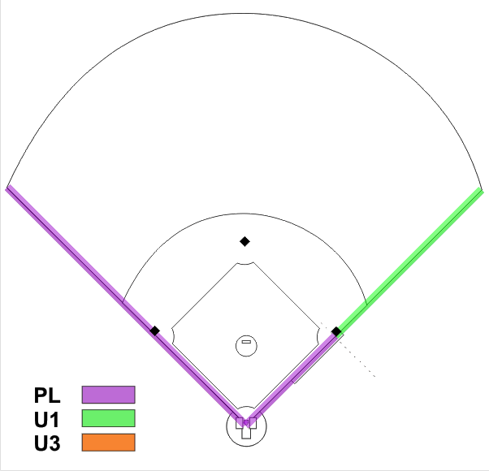
Fair / Foul
U3 In
Notes:
With U3 “in”
PL has responsibility up to the front edge of first and everything on the third base side
U1 has from the front edge of first base to the fence

Slide 24
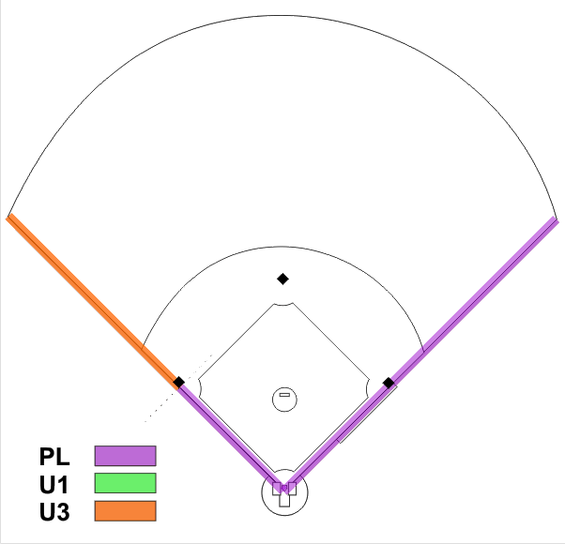
Fair / Foul
U1 In
Notes:
With U1 “in”
PL has responsibility up to the front edge of third and everything on the first base side
U3 has from the front edge of third base to the fence

Slide 25
Fly Ball Coverage
MUST GO OUT on a
“Trouble Ball”,
Foul Fly Ball, or Fair/Foul
OPTIONAL for
“Routine” Fly Ball

Slide 26
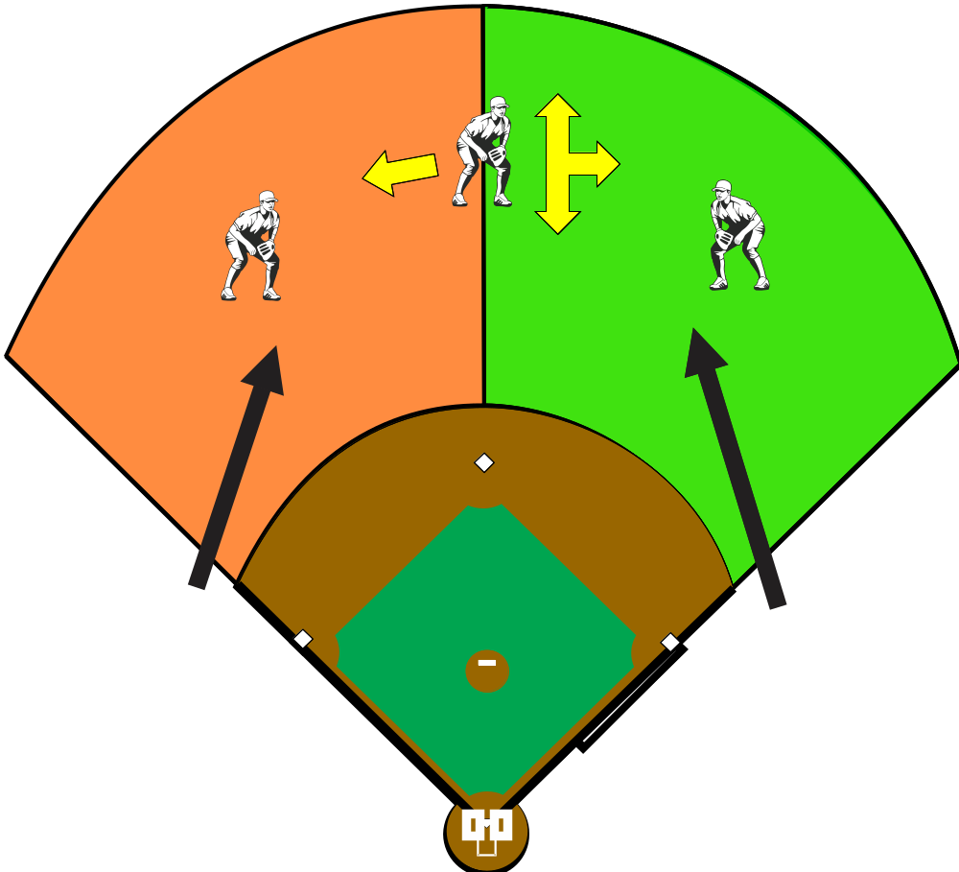
Fly Ball Coverage
U1 & U3
On the corners
Notes:
When U1 and U3 are “on the wings”, PL has no fly ball responsibility in the outfield
U1 has right field and the center fielder moving straight forward or backward or toward right field
U3 has left field and the center fielder moving toward left field
If there is a question who has the ball on a hit to the center fielder, U1 has precedence….he is the “key”

Slide 27
U1 is the “KEY”
for rotation when U1 and U3 are on the corners
Notes:
With U1 and U3 “on the wings’
U1 is the “KEY” to rotation
Even if he is wrong…he is RIGHT
If U1 goes out, even if error, he is the only one to go out
If U1 does NOT go out, then U3 goes out on only on a fly ball in his are of responsibility
If any umpire “goes out”
COVERAGE REVERTS TO 2-UMPIRE MECHANICS

Slide 28
Think of it like all umpires are connected by a “string”
Notes:
Think of it like all umpires are tied together.
If one goes out, he “pulls” all of the other with him

Slide 29
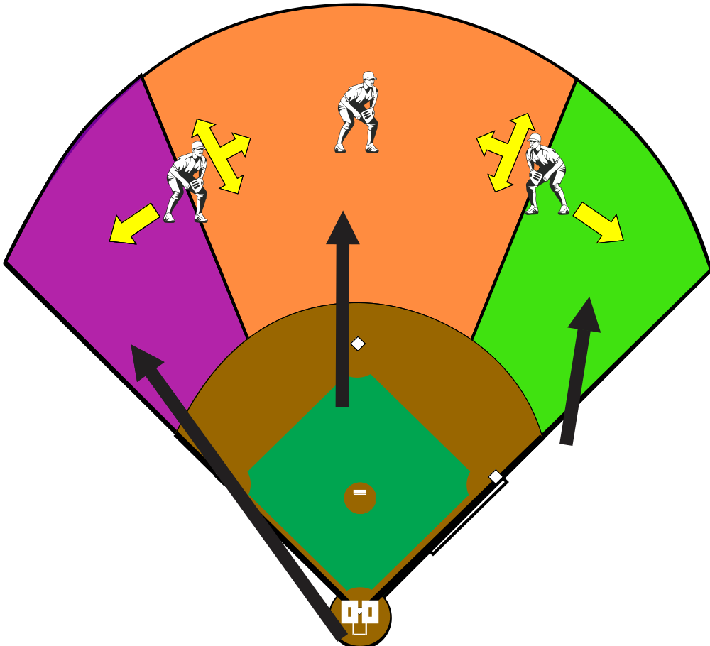
Fly Ball Coverage
U3 IN
Notes:
With U3 “inside”
PL has the right fielder moving toward the foul line
U3 has the center fielder moving straight forward or backward and toward left field -- His half of the “V” (third base side)
U1 has the right fielder and the center fielder moving toward right field

Slide 30
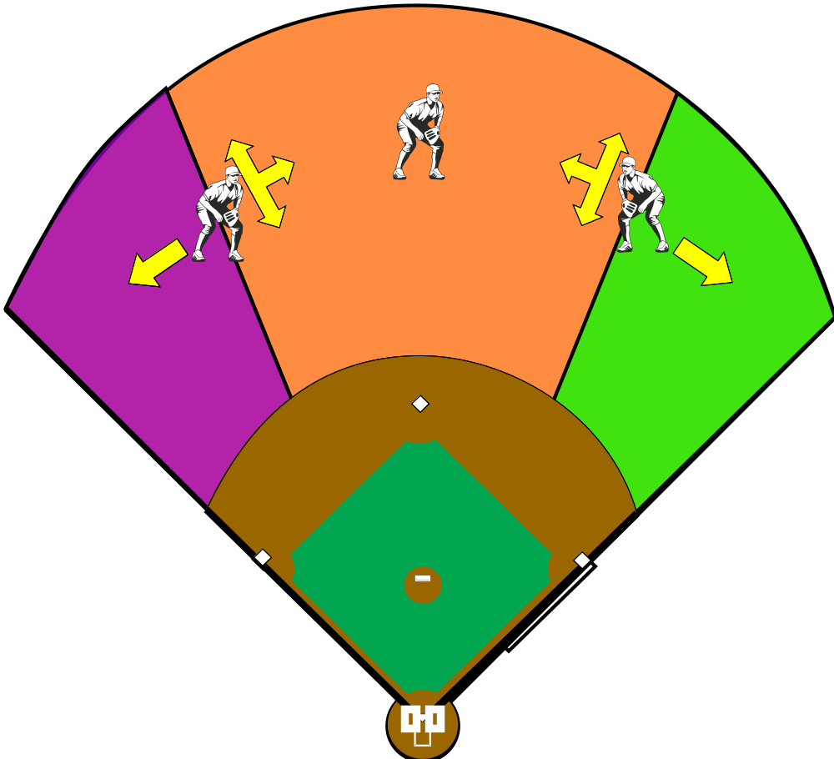
Fly Ball Coverage
U1 IN
Notes:
With U1 “inside”
PL has the right fielder moving toward the foul line
U1 has the Right fielder moving forward or backward and toward center field and the center fielder moving toward right field – His half of the “V” (first base side of the “V”)
U3 has left field and the center fielder moving straight forward and backward or toward left field

Slide 31
If U1 or U3 “goes out”
Coverage in infield reverts to
2-Umpire Mechanics
Notes:
Coverage reverts to 2-umpire mechanics
That’s why you stay in the outfield – let the other two umpires do their job

Slide 32
If you GO OUT
You STAY OUT
Notes:
If you GO OUT…you STAY OUT
Don’t come back in and get everyone confused
Stay in the outfield and observe playing action in case something happens and the crew needs to get together to get a call right
When playing action is over, go back to your position

Slide 33
Double Call Video

Slide 34
Rotations in
3-Umpire Mechanics
Rotations depend on
where the runner(s) are on the base(s)

Slide 35
Rotations in
3-Umpire Mechanics
Notes:
Think of a line splitting the field in two.
If there are NO runners on base, or a runner on 1st ONLY, then rotation is to the LEFT for all umpires
If there is a runner on the 3rd base side of the field (that is, on 2nd and/or 3rd), rotation for the BASE umpires is to the RIGHT
(PL will stay home with runner in scoring position)

Slide 36
Rotation anytime there
Are NO runners or a runner on 1st ONLY

Slide 37
Rotation anytime there
Is a runner(s)
On 2nd and/or 3rd

Slide 38


The SLIDE Rotation
Runner(s) in scoring position and
PL is staying home
Notes:
The Slide rotation is used when there are runners in scoring position (on 2nd and/or 3rd) and PL is staying home
With a runner or runners on the 3rd base side of the field, U1 and U3 must move in a rotation to the RIGHT to cover plays at 1st, 2nd, and 3rd.
U3 will initially move into a working area between 2nd and 3rd
As U1 comes into the infield to the working area between 1st and 2nd, he will notify U3 that he is inside (e.g.; “I’m IN, Cover 3rd).
U3 then moves into position to cover plays at 3rd, and U1 will have any play at 1st or 2nd.

Slide 39
NO RUNNERS
ON BASE

Slide 40
NO RUNNERS
U1 Goes Out

Slide 41
NO RUNNERS
U3 Goes Out

Slide 42
NO RUNNERS
Base Hit

Slide 43
NO RUNNERS
Infield Hit

Slide 44
Runner on 1st

Slide 45
Runner on 1st
U1 Goes Out

Slide 46
Runner on 1st
U3’s Responsibility

Slide 47
Runner on 1st
Fly Ball
PL’s Responsibility

Slide 48
Runner on 1st
Base Hit

Slide 49
Runner on 1st
Infield Hit
Possible
double play

Slide 50
Runner on 1st
Pickoff at First

Slide 51
Runner on 1st
Steal of 2nd

Slide 52
Runner on 2nd
w/ U2 “In”

Slide 53
Runner on 2nd
Fly Ball
U1’s Responsibility

Slide 54
Runner on 2nd
Fly Ball
U3’s Responsibility

Slide 55
Runner on 2nd
Fly Ball
PL’s Responsibility

Slide 56
Runner on 2nd
w/ U2 “Out”
Crew option with
2 outs ONLY

Slide 57

Runner on 3rd

Slide 58
Runner on 3rd
Fly Ball
U1’s Responsibility
This is the
MOST OFTEN MISSED ROTATION in 3-umpire mechanics

Slide 59
Runner on 3rd
Fly Ball
U3’s Responsibility

Slide 60
Runner on 3rd
Base Hit

Slide 61
Runner on 3rd
Hit to Infield

Slide 62
Runner on 3rd
Pickoff at Third

Slide 63
Runners on
1st & 2nd

Slide 64
Runners on
1st & 2nd
Fly Ball
U1 Goes Out

Slide 65
Runners on
1st & 2nd
Fly Ball
U3’s Responsibility

Slide 66
Runners on
1st & 2nd
Fly Ball
PL’s Responsibility

Slide 67
Runners on
1st & 2nd
Base hit

Slide 68
Runner on
1st & 2nd
Hit to Infield

Slide 69
Runners on
1st and 3rd

Slide 70
Runners on
1st and 3rd
Fly Ball
U1 Goes Out

Slide 71
Runners on
1st and 3rd
Fly Ball
U3’s Responsibility

Slide 72
Runners on
1st and 3rd
Fly Ball
PL’s Responsibility

Slide 73
Runners on
1st and 3rd
Base Hit

Slide 74
Runners on
1st and 3rd
Infield Hit

Slide 75
Runners on
1st and 3rd
Steal & Rundown

Slide 76
Runners on
2nd & 3rd
With U1 “In”

Slide 77
Runners on
2nd & 3rd
With U1 “In”
Fly ball
U1’s Responsibility

Slide 78
Runners on
2nd & 3rd
With U1 “In”
Fly ball
U3’s Responsibility

Slide 79
Runners on
2nd & 3rd
With U1 “In”
Fly ball
PL’s Responsibility

Slide 80
Runners on
2nd & 3rd
With U1 “In”
Base Hit

Slide 81
Runners on
2nd & 3rd
With U1 “In”
Infield Hit

Slide 82
Runners on
2nd and 3rd
With U1 “Out”
Crew option with
2 outs ONLY

Slide 83
Runners on
2nd and 3rd
With U1 “Out”
Fly Ball
U1 Goes Out

Slide 84
Runners on
2nd and 3rd
With U1 “Out”
Infield Hit

Slide 85
Bases
Loaded

Slide 86
Bases Loaded
Fly Ball
U1’s Responsibility

Slide 87
Bases Loaded
Infield Hit
Possible Double Play

Slide 88
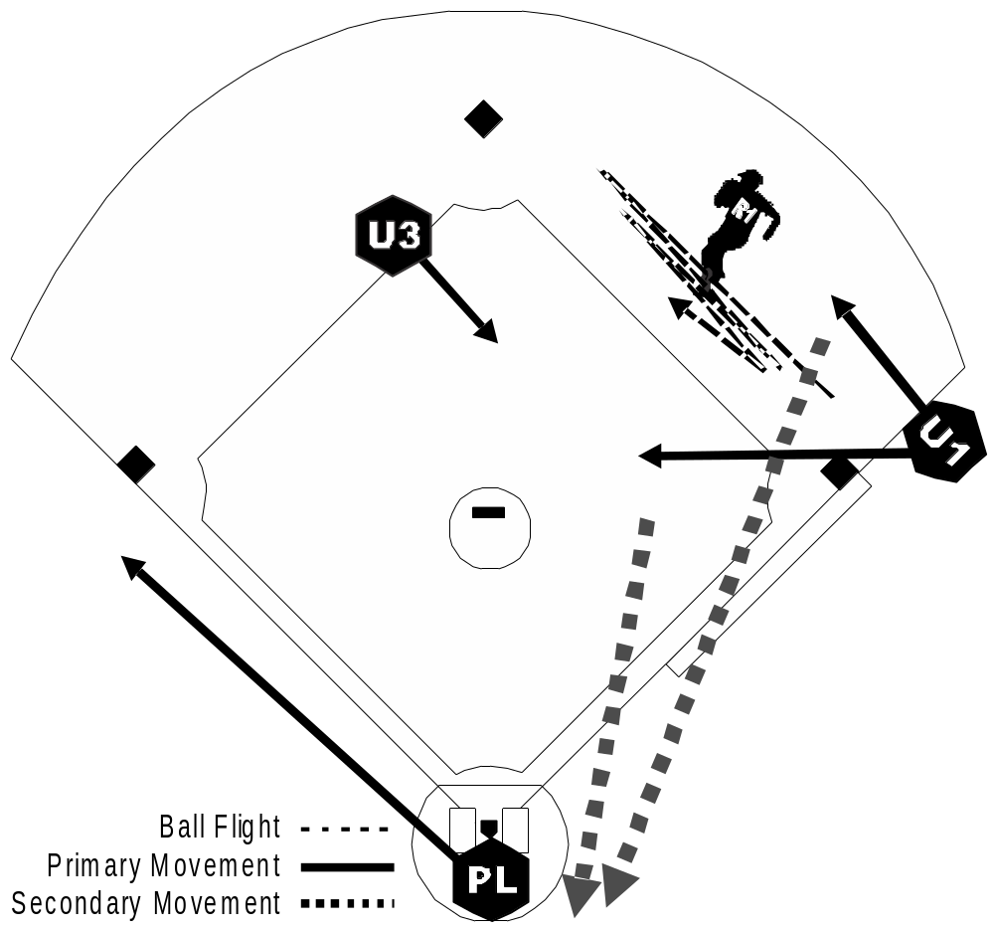
Rundown
Runner on
1st

Slide 89
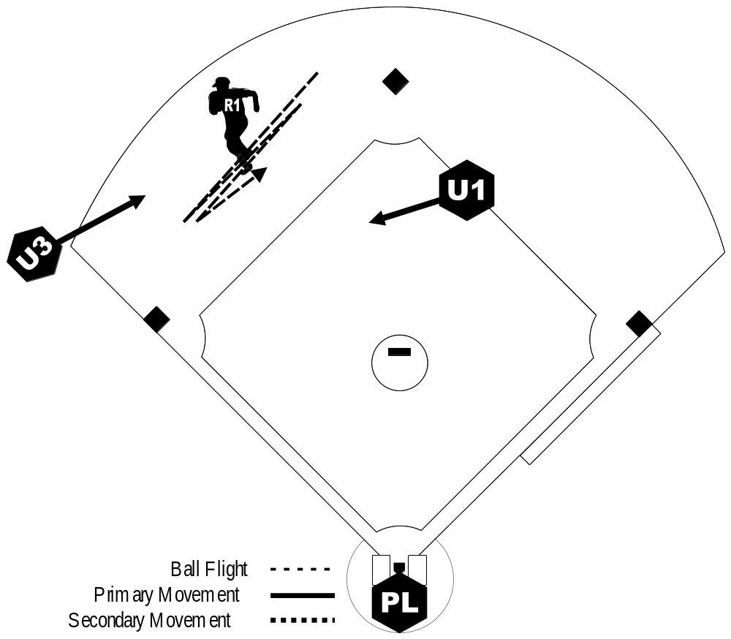
Rundown
w/ U1 “inside”
Runner on
2nd

Slide 90
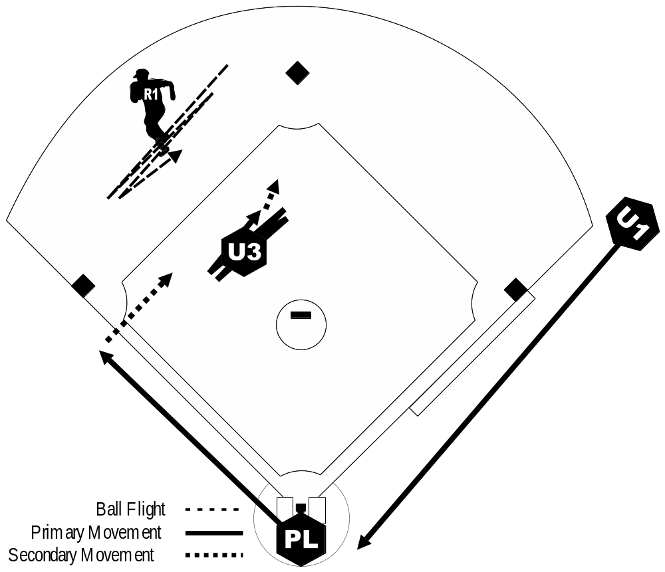
Rundown
w/ U1 “outside”
Runner on
2nd

Slide 91
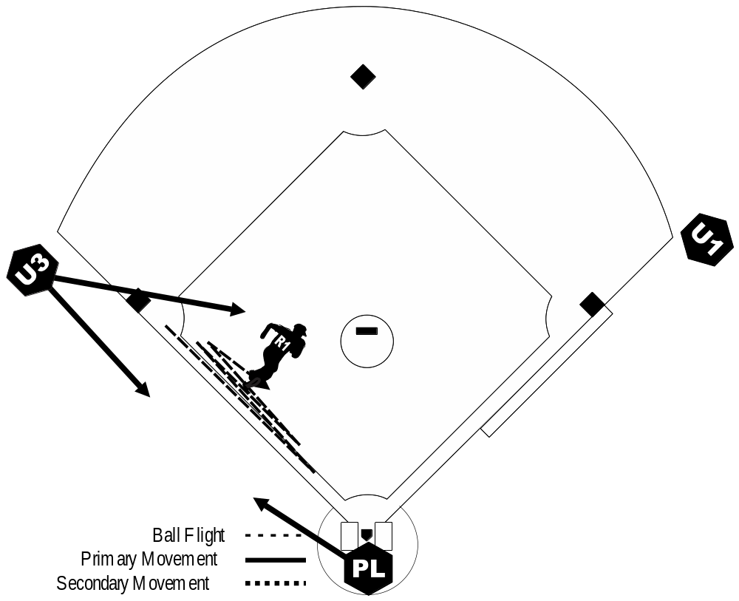
Rundown
Runner on
3rd

Slide 92
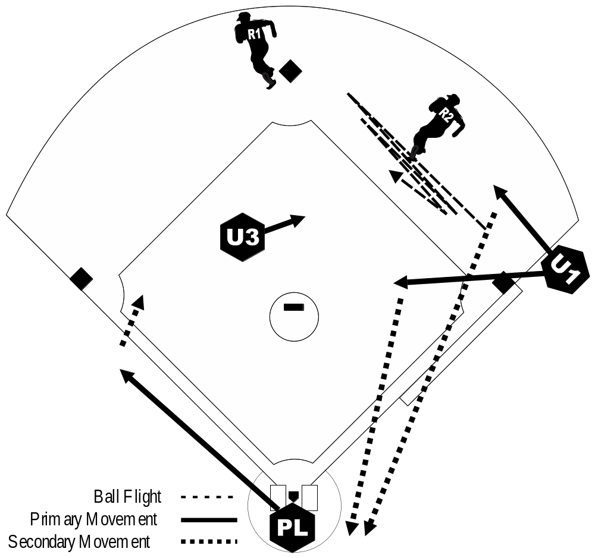
Rundown
between 1st & 2nd w/ Runners on
1st and 2nd

Slide 93
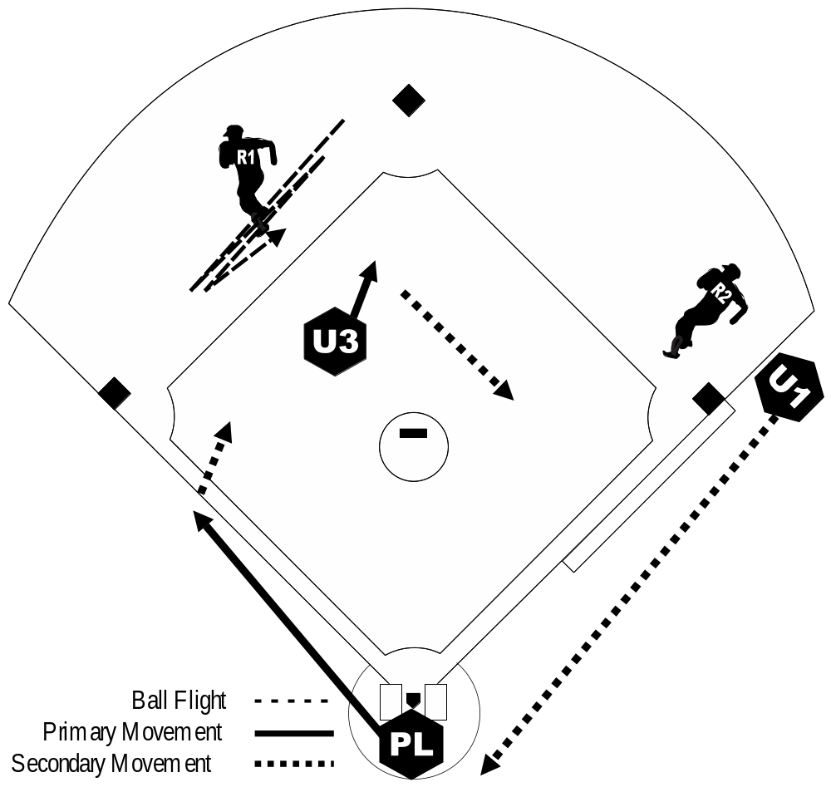
Rundown
Between 2nd & 3rd
w/ Runners on
1st and 2nd

Slide 94
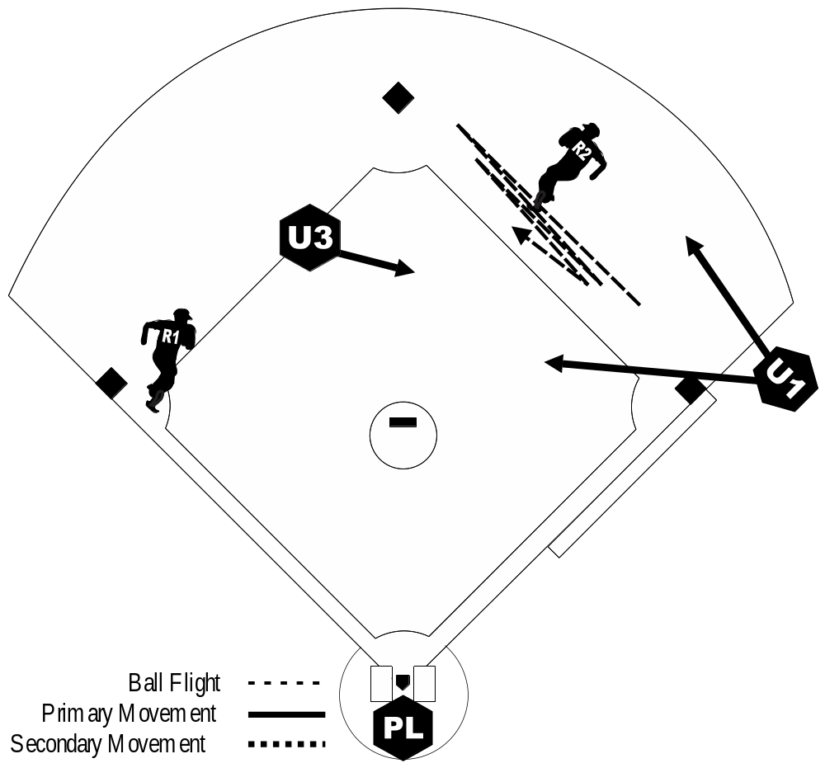
Rundown
between 1st & 2nd
w/ Runners on
1st & 3rd

Slide 95
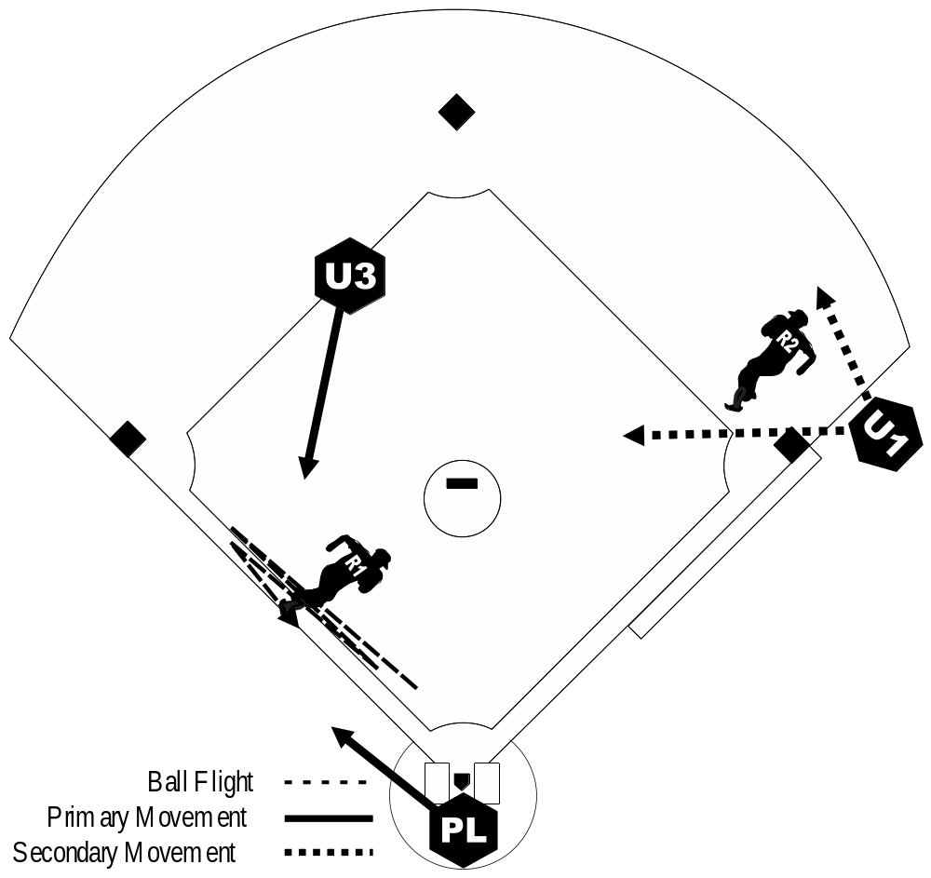
Rundown
between 3rd & Home
w/ Runners on
1st & 3rd

Slide 96
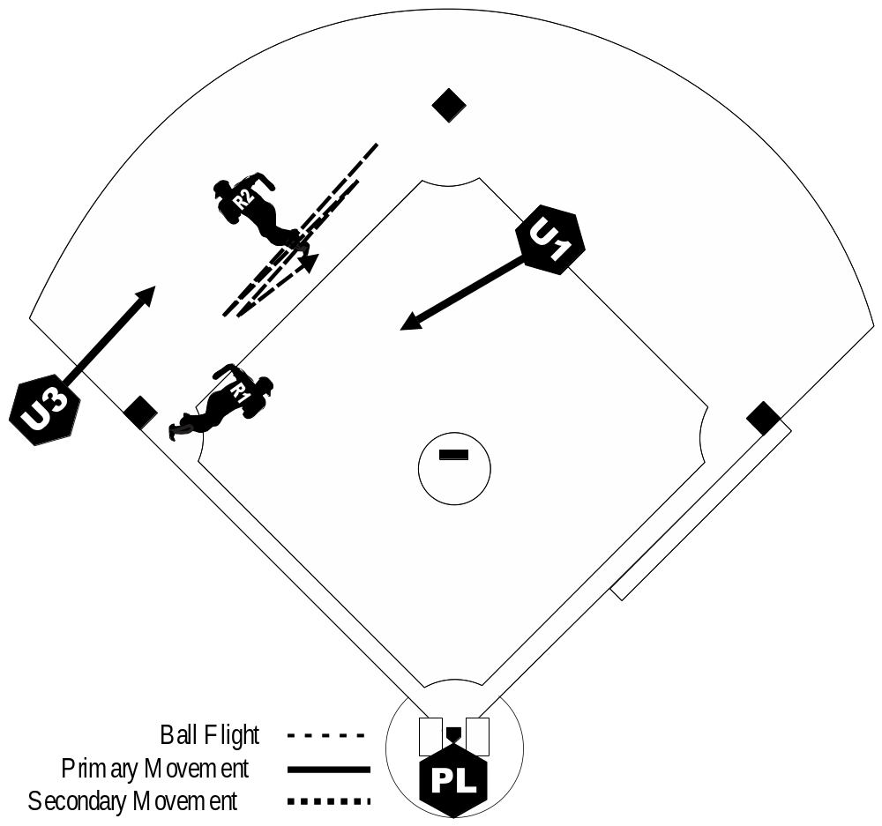
Rundown
between 2nd & 3rd
and U1 “inside”
w/ Runners on
2nd & 3rd

Slide 97
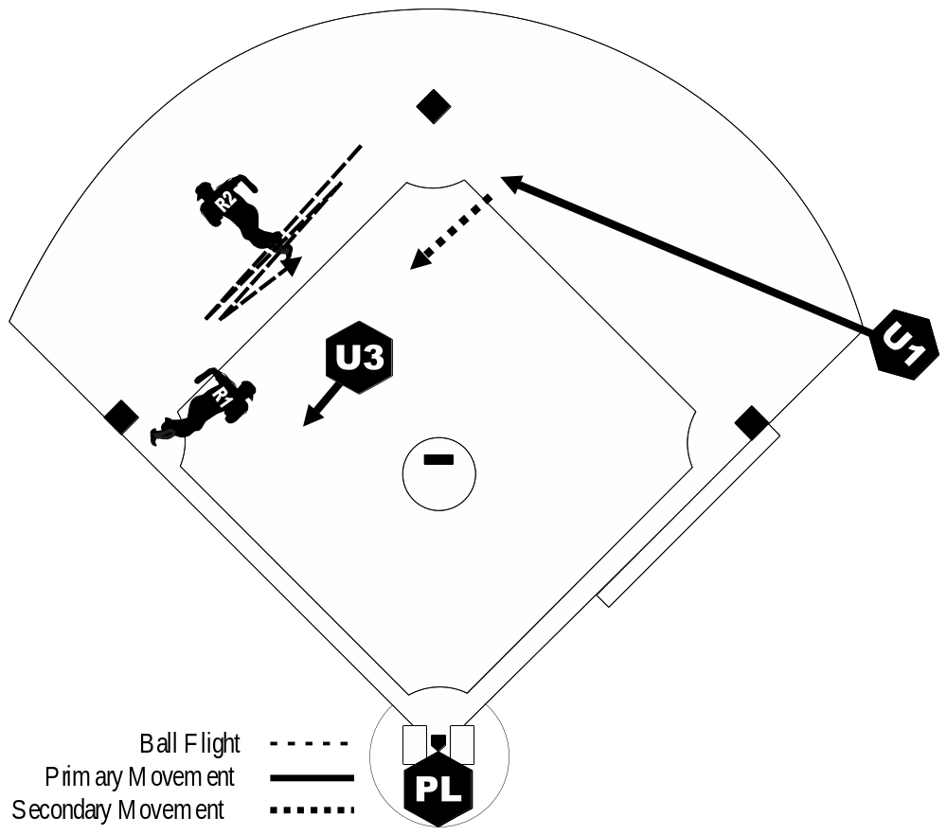
Rundown
between 2nd & 3rd
and U1 “outside”
w/ Runners on
2nd & 3rd

Slide 98
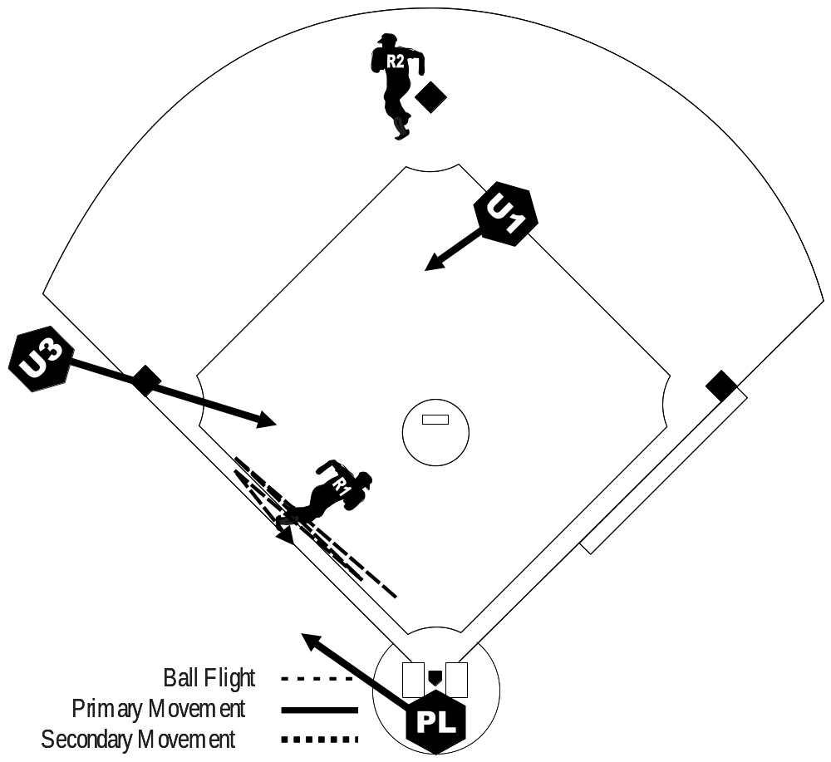
Rundown
between 3rd & Home
and U1 “inside”
w/ Runners on
2nd & 3rd

Slide 99
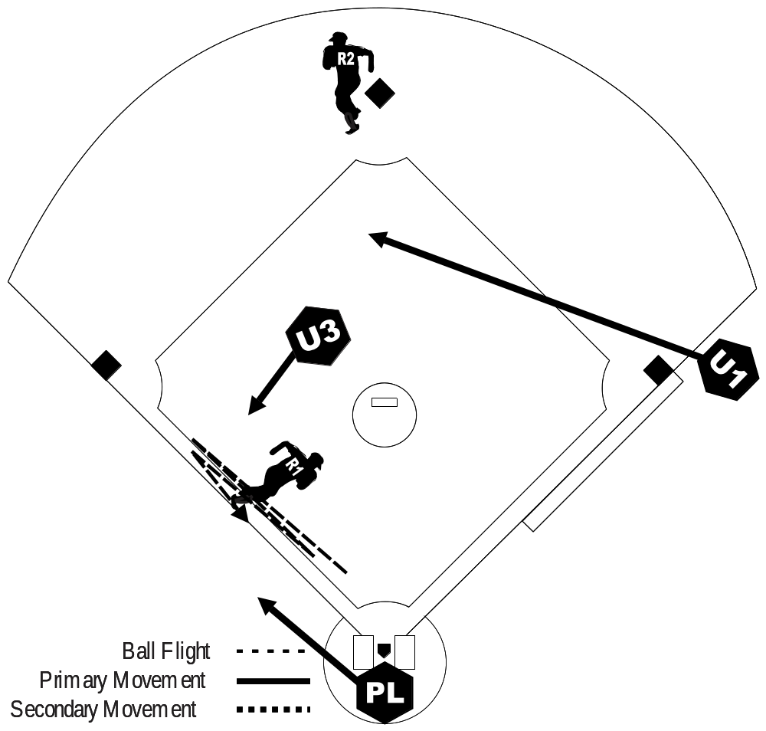
Rundown
between 3rd & Home
and U1 “outside”
w/ Runners on
2nd & 3rd

Slide 100
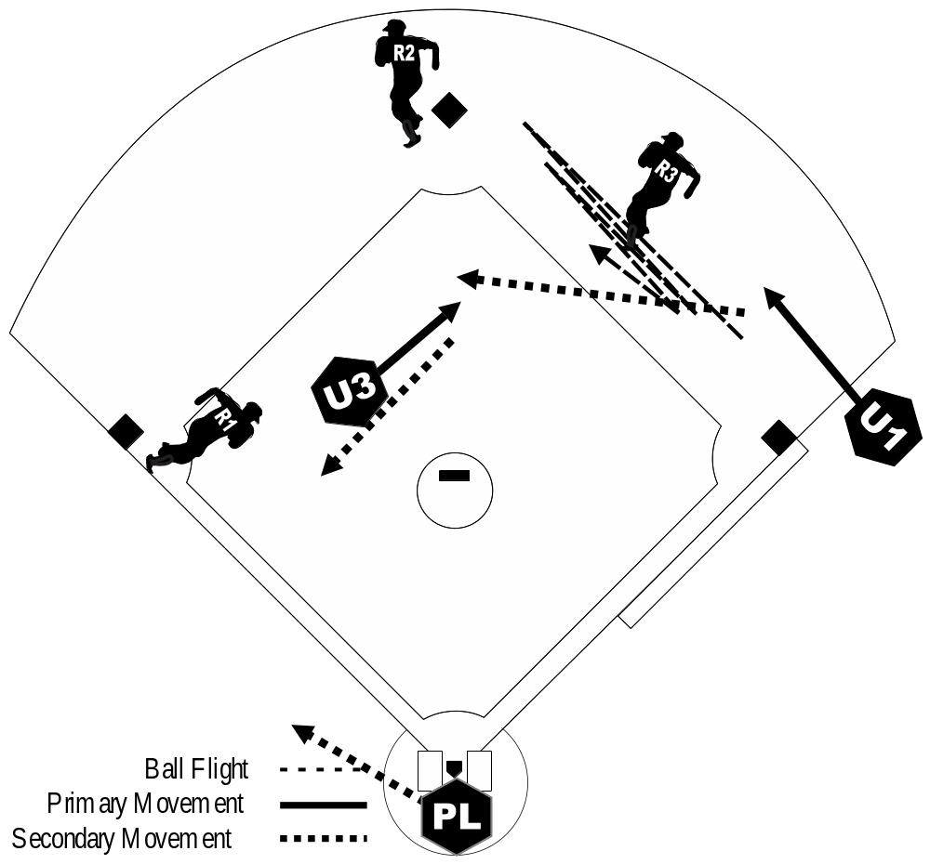
Rundown
between 1st & 2nd
w/ Bases Loaded

Slide 101
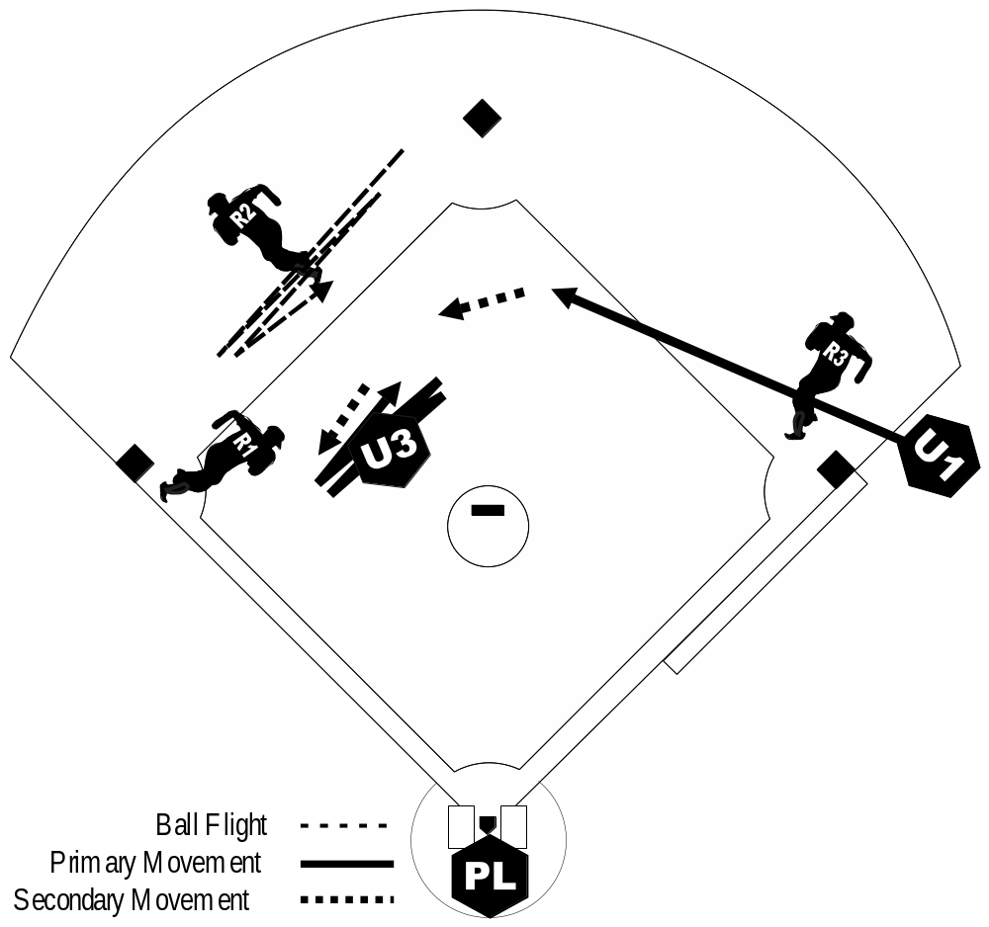
Rundown
between 2nd & 3rd
w/ Bases Loaded

Slide 102
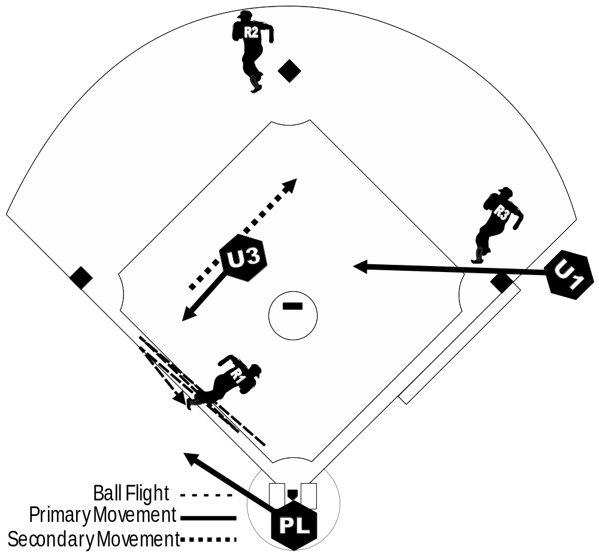
Rundown
between 3rd & Home
w/ Bases Loaded

Slide 103
No Matter What Happens…..or
Who misses a rotation
FILL THE HOLE !!!
We can talk about missed
coverage later……….but
SOMEONE has to MAKE THE CALL

Slide 104
3-umpire mechanics

